Slide 1


04060823
LAB
2025
c Based Project
PROJECT
A C BASED CONSOLE APPLICATION FOR BOOKSTORE MANAGEMENT
PROJECT PRESENTATION

Slide 2

TABLE OF
CONTENTS
01
Background
02
Problem &solution
The need of efficient book management in bookstore
Need for a user friendly system for both store admins and customers
03
Features
04
Code structure
The feature and functionalities of the project
Shows the system architecture and code structuer of the project
Our content today is
divided into four parts.
Each part will be described
with examples.

Slide 3
01
Background

Slide 4





Book Store
Books store handels large amount of book which is very hard to manually do.
Customer
Customer wants to know the availbility of the book and wants to search the book
Digital Management
Admin needs a digital system ko track its sales and the available books

Slide 5



01
Background
Background of traditonal book store system
Errors and Inefficiencies in Manual Record-Keeping
Prone to human errors such as misentries or lost records.
Time-consuming and difficult to maintain.
Hard to interpret or retrieve past records.
Stock Mismanagement
Leads to overstocking, tying up capital in unsold inventory.
Causes understocking, resulting in lost sales and dissatisfied customers.
No real-time tracking, making it difficult to identify fast-moving or slow-moving books.
Challenges in Tracking Sales and Revenue
Manual calculations are prone to mistakes.
No real-time insights into financial performance.
Difficult to generate reports on bestsellers, seasonal trends, or profit margins.
Customer Inconvenience in Finding Books
No categorized digital inventory, making book searches difficult.
Customers rely on staff assistance, leading to inefficiencies.
Affects customer satisfaction and reduces store efficiency.
Notes:
Manual record-keeping not only leads to errors and inefficiencies but also consumes a significant amount of time and effort. Handwritten records can be misplaced, damaged, or difficult to interpret, leading to discrepancies in stock and sales data.
Stock mismanagement due to the lack of a real-time tracking system can result in overstocking, which ties up capital in unsold inventory, or understocking, which leads to lost sales and dissatisfied customers. Without a proper system, identifying fast-moving or slow-moving stock becomes challenging, making it harder to optimize inventory levels.
Tracking sales and revenue manually is cumbersome and prone to miscalculations. Business owners often struggle to get real-time insights into their financial performance, which affects decision-making. Generating reports on best-selling books, seasonal trends, or profit margins requires excessive manual effort.
Customers, on the other hand, find it frustrating to search for specific books in a manually managed bookstore. Without a categorized digital inventory, they often rely on staff assistance, which may not always be efficient. This not only affects customer satisfaction but also reduces the store's operational efficiency.

Slide 6
TABLE OF
CONTENTS
01
Background
02
Problem &solution
The need of efficient book management in bookstore
Need for a user friendly system for both store admins and customers
03
Features
04
Code structure
The feature and functionalities of the project
Shows the system architecture and code structuer of the project
Our content today is
divided into four parts.
Each part will be described
with examples.

Slide 7
02
Problem & Solution

Slide 8

PROBLEMS
Errors and Inefficiencies in Manual Record-Keeping
Stock Mismanagement
Challenges in Tracking Sales and Revenue
Customer Inconvenience in Finding Books

Slide 9
SOLUTIONS
Managing Books Efficiently
Improving Search Functionality
Handling Second-Hand Book Sales
Tracking Total Sales
Scalability & Future Improvements
Notes:
Managing Books Efficiently
Problem: How to store book details without using a database?
Solution: Implemented file-based storage (book_list.txt), storing book title, author, genre, and stock details.
Improving Search Functionality
Problem: Users need to search books by multiple criteria (title, author, genre).
Solution: Implemented a linear search algorithm that scans the book file and returns matching results efficiently.
Handling Second-Hand Book Sales
Problem: Customers should be able to sell used books back to the store.
Solution: Implemented a function that adds second-hand books into inventory and updates book_list.txt.
Tracking Total Sales
Problem: How to maintain a sales record without a database?
Solution: Created a sales tracking system that logs transactions in sales_list.txt, storing book name, price, and sale date.
Security for Admin Login
Problem: Prevent unauthorized access to admin features.
Solution: Implemented hardcoded credentials (admin/admin), but future plans include password encryption.
Data Persistence Without a Database
Problem: Data should remain saved even after the program is closed.
Solution: Used text files (book_list.txt, sales_list.txt) for permanent storage.
Scalability & Future Improvements
Problem: How to expand the project in the future?
Solution: Modularized the code into separate files (admin_backend.c, customer_backend.c) so that features can be easily added.

Slide 10
TABLE OF
CONTENTS
01
Background
02
Problem &solution
The need of efficient book management in bookstore
Need for a user friendly system for both store admins and customers
03
Features
04
Code structure
The feature and functionalities of the project
Shows the system architecture and code structuer of the project
Our content today is
divided into four parts.
Each part will be described
with examples.

Slide 11
03
03
Features
Features

Slide 12
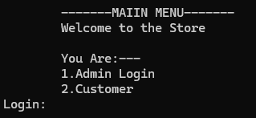
MAIN PAGE

Slide 13
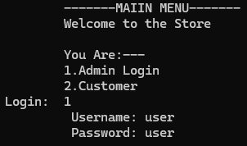
ADMIN LOGIN PAGE

Slide 14
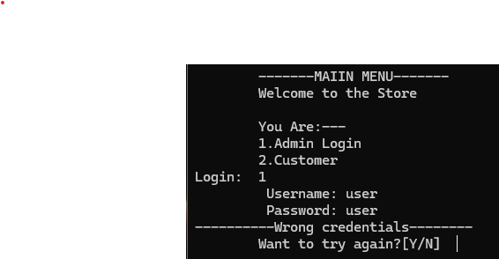
ADMIN LOGIN ERROR

Slide 15
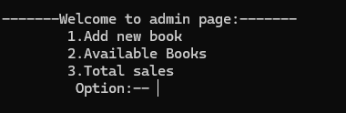
ADMIN MENU

Slide 16
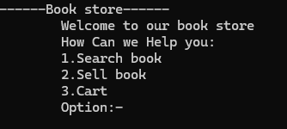
CUSTOMER MENU

Slide 17
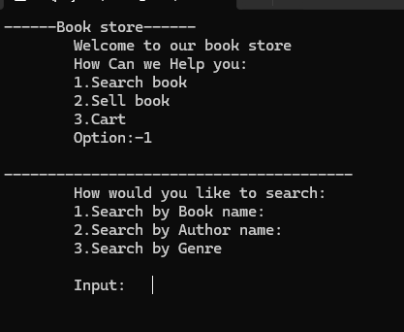
SEARCH MENU OPTION

Slide 18
TABLE OF
CONTENTS
01
Background
02
Problem &solution
The need of efficient book management in bookstore
Need for a user friendly system for both store admins and customers
03
Features
04
Code structure
The feature and functionalities of the project
Shows the system architecture and code structuer of the project
Our content today is
divided into four parts.
Each part will be described
with examples.

Slide 19
04
Code Structure

Slide 20
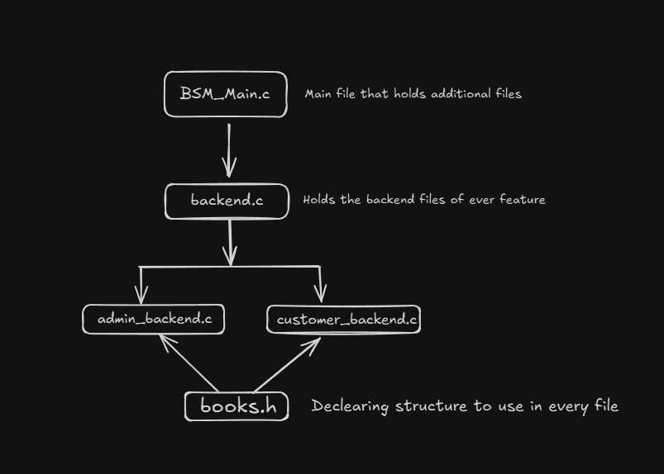
Code structure

Slide 21
Text file to store the data
Book_list.txt
Second_hand.txt
Cart.txt

Slide 22


TIMELINE
This timeline provides a structured roadmap for the project, ensuring a systematic approach to development. Let me know if you need any changes! 🚀
Proposal Presentation
Define project scope, objectives, and requirements. Design system architecture, data storage, and features. |1 Week
Coding
TImeline
plays an important
role in concept and
project direction
Implement features for admin and customer panels. | 2-3 Weeks

Slide 23



Testing and Debugging
Perform unit testing, bug fixes, and improvements. | 1-2 days
Timeline of the project
To ensure a structured and efficient project development, we divided the work into different phases:
Proposal & Planning (Week 1-2)
Coding (Week 2-3)
Testing & Debugging ( 1-2)days
Documentation & Finalization (Week 8)
Documentation
Create README, user guide, and project report. | 1 Week

Slide 24

Q&A
Q
Question
O
Opinion
Any question about our project
Give use the opinion that can be added to make the project better

Slide 25






OUR TEAM
Let's meet our team members
who are stars of this project
AVIYAN SHARMA
NISHAN PARAJULI
ALOK SHARMA
ANVIL SHAKYA
Student
Student
Student
Student
THA081BEI008
THA081BEI0023
THA081BEI004
THA081BEI006

Slide 26
OUR TEAM
Let's meet our team members
who are stars of this project
AVIYAN SHARMA
NISHAN PARAJULI
ANVIL SHAKYA
Student
Student
Student
THA081BEI008
THA081BEI0023
THA081BEI006
ALOK SHARMA
Student
THA081BEI004

Slide 27
OUR TEAM
Let's meet our team members
who are stars of this project
AVIYAN SHARMA
NISHAN PARAJULI
Student
Student
THA081BEI008
THA081BEI0023
ALOK SHARMA
ANVIL SHAKYA
Student
Student
THA081BEI004
THA081BEI006

Slide 28
OUR TEAM
Let's meet our team members
who are stars of this project
NISHAN PARAJULI
Student
THA081BEI0023
ALOK SHARMA
ANVIL SHAKYA
AVIYAN SHARMA
Student
Student
Student
THA081BEI004
THA081BEI006
THA081BEI008

Slide 29
OUR TEAM
Let's meet our team members
who are stars of this project
ALOK SHARMA
ANVIL SHAKYA
AVIYAN SHARMA
NISHAN PARAJULI
Student
Student
Student
Student
THA081BEI004
THA081BEI006
THA081BEI008
THA081BEI0023

Slide 30

THANK YOU
FOR TAKING THIS TORTURE

